Slide 1
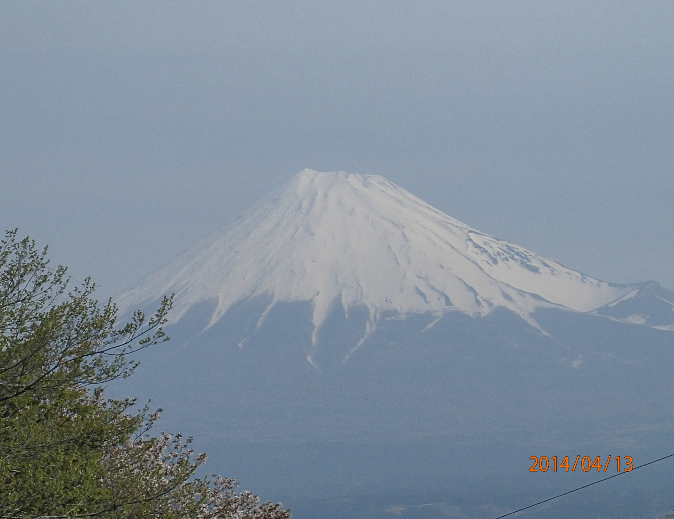
The 5th Advanced Forum on Tribology,
2014 Fuji

Slide 2
The 5th Advanced Forum on Tribology,
2014 Fuji
2014/4/12～4/13
104 Attendees
4 Keynotes lectures
1 special lecture
15 Invited speeches
3 posters
26 exhibitions
The Forum is successfully closing
with support of
JATCO staffs and JATCO CO !

Slide 3
Thank you for your cooperation
See you next year in 武漢………

Slide 4
The 5th Advanced Forum on Tribology, 2014 Fuji

Slide 5
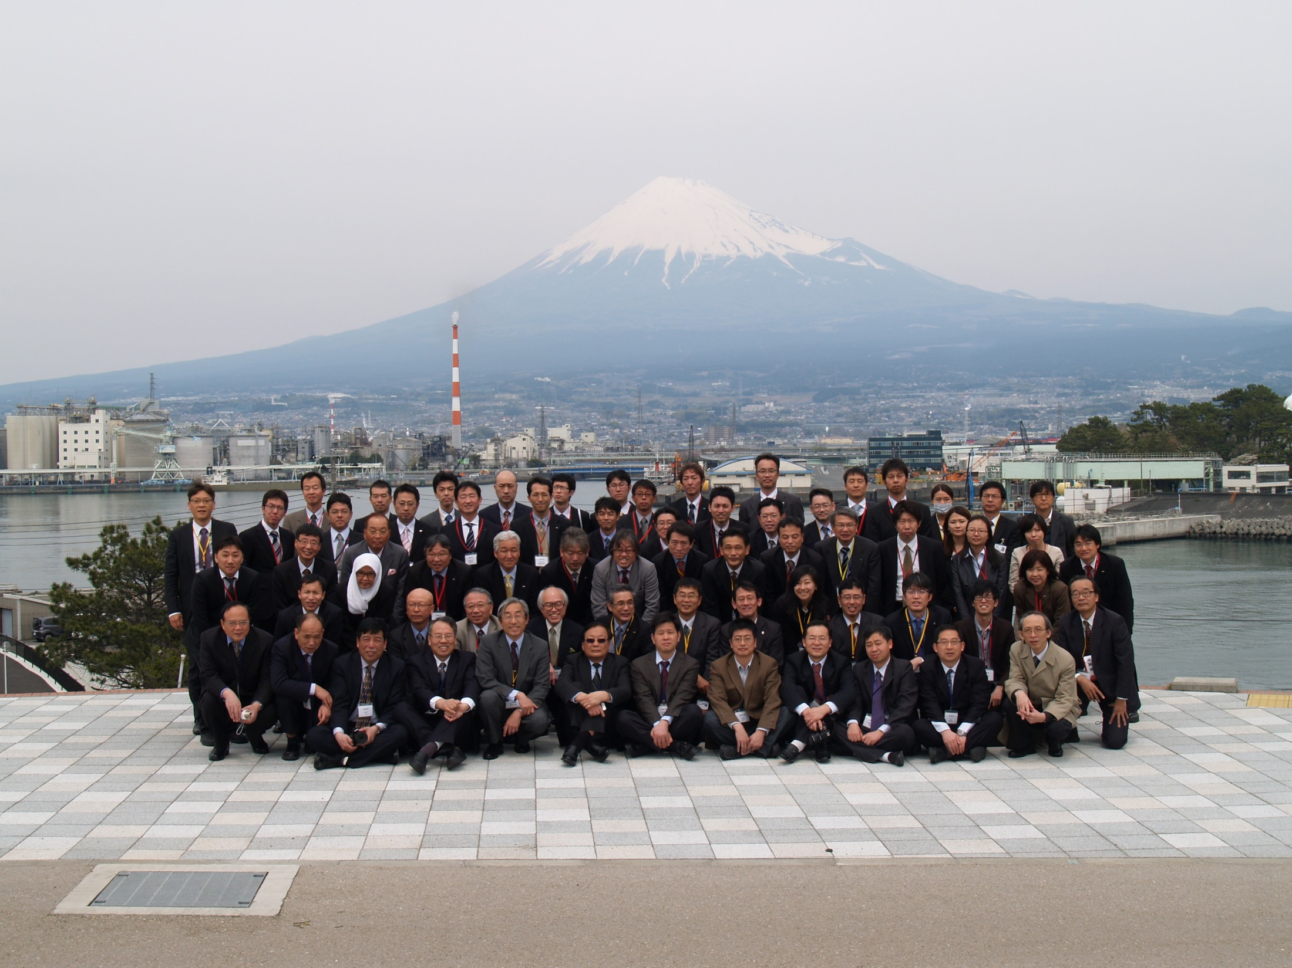
The 5th Advanced Forum on Tribology, 2014 Fuji

